Slide 1
Hardware-accelerated regular expression matching for high-throughput text analytics
Author: Kubilay Atasu, Florian Doerfler, Jan van Lunteren, Christoph Hagleitner
Publisher: 2013 FPL
Presenter: Yuen-Shuo Li
Date: 2013/10/30
Notes:
心得是這篇好多錯字….

Slide 2
Introduction
Regex matching is one of the most computationally intensive tasks in network intrusion detection systems, such as Snort, and in information extraction systems, such as IBM’s SystemT text analytics software [2].

Slide 3
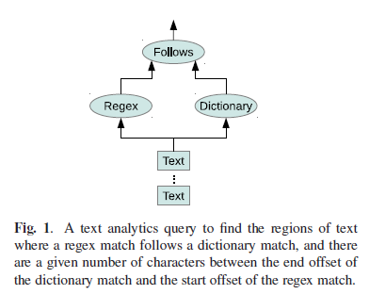
Introduction
Regex matching and dictionary matching operations can consume up to 90 percent of the execution time in SystemT.

Slide 4
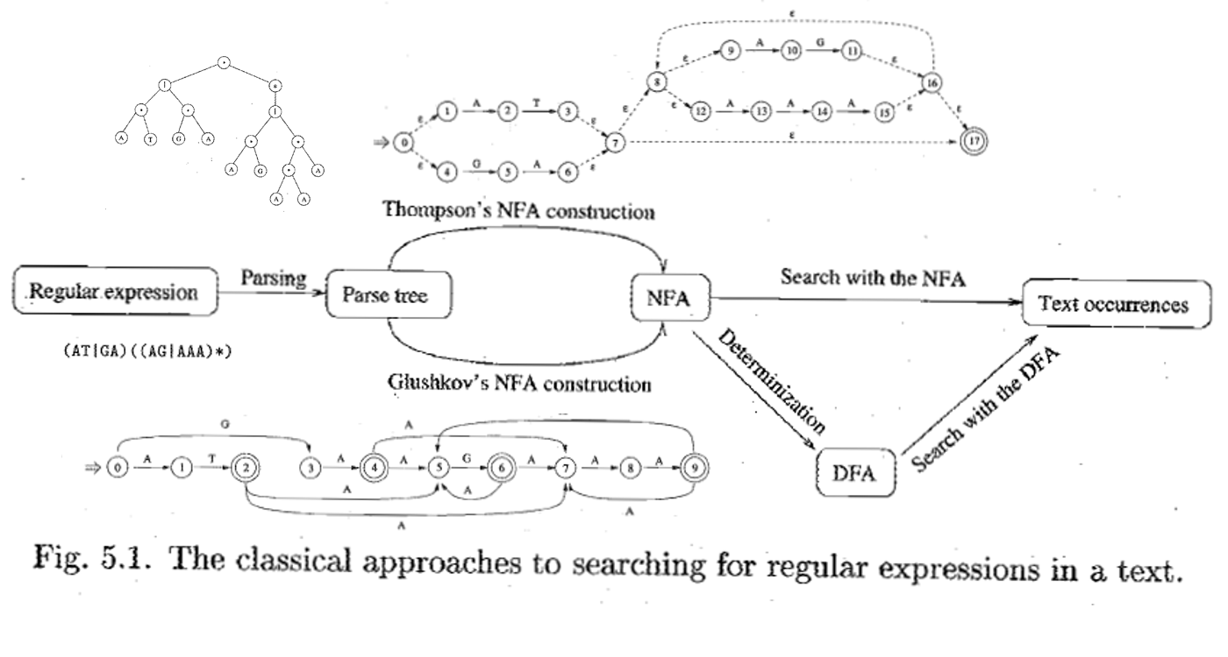
Introduction
Such systems require support for advanced regex matching features, such as start offset reporting and capturing groups.
However, existing regex matching architectures based on reconfigurable nondeterministic state machines and programmable deterministic state machines are not designed to support such features.

Slide 5
Introduction
We describe a novel architecture that supports such advanced features including start offset reporting and capturing groups using a network of state machines.
Experiments on an Altera Stratix IV FPGA, using regexs from a real life text analytics benchmark, show that a throughput rate of 16 Gb/s can be reached.

Slide 6
Start offset report
State-of-the-art regex architectures based on DFAs and NFAs simply raise a flag to signal a regex match, which only reveals the end offset of the match in the input stream.
The start offsets can be calculated based on the end offsets if the regex has a fixed length, but this is rarely the case.
For instance, in the regex a*b[ˆa]*ca*b, any number of repetitions of a in a*b and in ca*b, and any number of repetitions of ˆa between these two are allowed, making the difference between start and end offsets variable.
Notes:
往回推是有問題的

Slide 7
Start offset report
A naive approach for start offset reporting involves recording the start offset each time the first character (or a fixed length prefix) of a regex is encountered in the input stream.
The problem with such an approach is that a occurs multiple times in the regex a*b[ˆa]*ca*b. Assume, for instance that we are given the input string abcabcab.
abcabcab
Notes:
紀錄碰到的每一個可以當開頭的字元也是有問題的

Slide 8
Start offset report
abcabcab
This simple example demonstrates that multiple start offset values must be remembered at any time by a regex matcher and these values must eventually be associated with different end offsets.
The existing regex accelerator architectures based on programmable DFAs and reconfigurable NFAs do not support such a functionality.
Notes:
一般的 DFA, NFA 沒有考慮這點

Slide 9

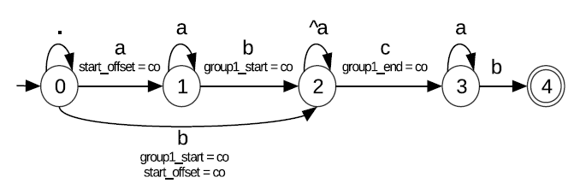
Capturing group
co: current offset
The subexpression b[ˆa]*c is captured using parantheses.
The delimiter (? marks the start of a capturing group, and the matching closing paranthesis marks the end of the capturing group. When one or more capturing groups are
Notes:
這個問題比較單純，但也是一般 DFA 和 NFA 不會去考慮的問題

Slide 10
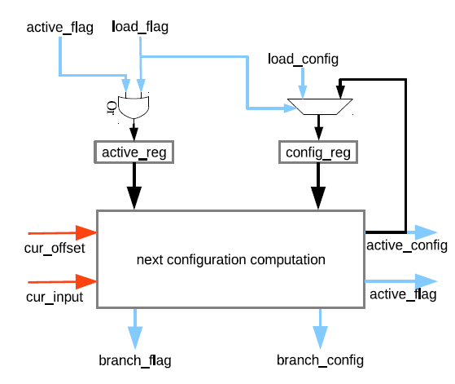
Architectures
We assume that multiple replicas of the same state machine are implemented in hardware.
Notes:
這是單個 State Machine 的架構

Slide 11
Architectures
Replica can be in an active mode or in an inactive mode, and this information is stored in a register (active reg).
The inactive replicas are always at state 0 and no state transitions can occur in those state machines.
Notes:
FSM 有分 active 和 inactive mode

Slide 12
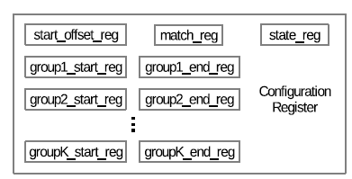
Architectures
For each active replica, a configuration register (config_reg).
state_reg: current state
match_reg: a match signal
start_offset_reg: the start offset of the matching regex in the input stream
Notes:
透過 load_config 接收訊息，Config 裡面有多個資訊

Slide 13
Architectures
involving a state, a match signal, a start offset, and zero or more capturing group start and end offsets
Notes:
透過 active_config 傳遞訊息

Slide 14
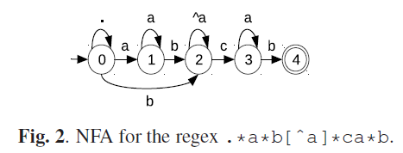
Architectures
remains in state 0
Replica 0
0
0
0
a
b
Replica 1
0
1
2
Replica 2
0
0
2

Slide 15
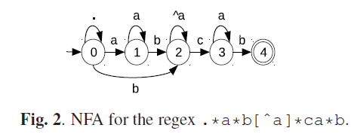
Architectures
If the regex is non-anchored, the replica 0 always remains active, and at state 0.
If the regex is anchored, the replica 0 remains active for one cycle only, and performs a single state transition that starts from state 0.
Anchor: ^adcde
Non-Anchor: abcde

Slide 16
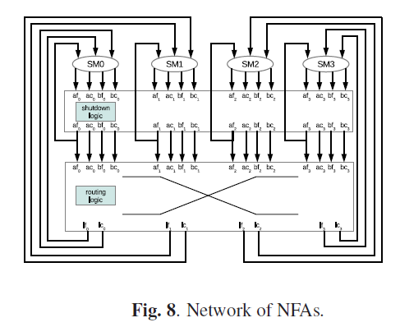
Architectures
Our architecture utilizes multiple replicas of a state machine that operate in parallel. An interconnection network that enables these replicas to communicate with each other is essential.
Notes:
FSM 有可能 active，有可能 inactive，而且 FSM 還能讓別的 FSM active，所以分配很重要

Slide 17
Interconnection Network
In general, there can be multiple non-deterministic states in an NFA, and multiple branch flag signals can be activated in parallel by multiple active replicas.
Handling all of these branches in parallel requires selecting multiple inactive replicas, and routing multiple branch config values to the selected replicas in parallel.
Implementing such a functionality without introducing multiple delay cycles into the state transition loop is a nontrivial task, and requires an efficient interconnection network.
Notes:
這邊就是講剛剛提到的問題

Slide 18
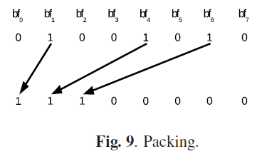
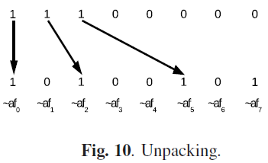
Interconnection Network
The parallel pack operation can be efficiently implemented using a reverse butterfly network, and additional control circuitry that uses parallel prefix computation [15].
bf: branch_flag
af: active_flag
[15]:Yedidya Hilewitz and Ruby B. Lee. Fast bit compression and expansion with parallel extract and parallel deposit instructions. In Proc. ASAP, pages 65–72, 2006.
Notes:
那麼如何分配呢？
簡單來說，概念就是找出那些 FSM 要讓別的 FSM active，再分配給還沒 inative 的人，
分配分兩個步驟。

Slide 19
Interconnection Network
Our architecture includes a shutdown logic to avoid redundant next state computations and to support leftmost match semantics.
If one or more transitions produce the same state in their active config or branch config data, the redundancy is eliminated by setting the active flag or branch flag signals to 0 in all of these configurations except one.
Notes:
有 shutdown logic 避免 reduntant，記得 left most

Slide 20
Start Offset Reporting Using Arbitration
we are going to show that if the only required regex feature is start offset reporting, the interconnection network architecture can be significantly simplified.
Notes:
接下來要介紹的是如果放棄 group capture 的功能的話，就可以簡化整個系統

Slide 21
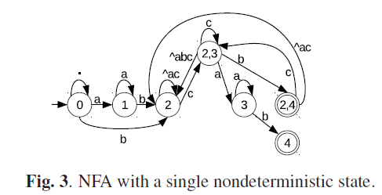
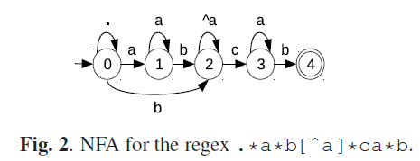
Start Offset Reporting Using Arbitration
we apply the powerset algorithm partially on the NFA of the regex to eliminate the nondeterminism from all the states except state 0
Notes:
將 NFA 轉成這個鳥樣

Slide 22
Start Offset Reporting Using Arbitration
Note that in such a case, the only replica that can assert the branch flag is the replica that implements the state 0.
Hence, branch flag and branch config signals can be eliminated from the remaining replicas for resource optimization.
Notes:
現在只有 replica 0 會啟動別的 FSM ，所以可以不用 branch flag

Slide 23
Start Offset Reporting Using Arbitration
Whenever the branch flag signal is asserted by the replica 0, if there are multiple inactive replicas, an arbitration logic must be used to select the replica that will be activated.
The solution is selecting the replica with the lowest index among all the inactive replicas, which can be efficiently implemented using a simple arbiter.
In this way, the complex interconnection network that utilizes pack/unpack operations is eliminated.
Notes:
用最簡單的方式分配，分配給 lowest index 的 inactive FSM

Slide 24
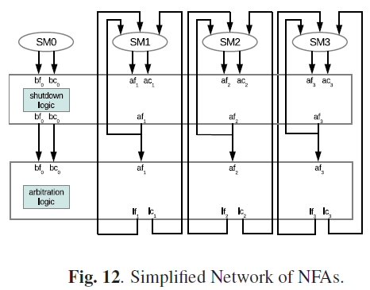
Start Offset Reporting Using Arbitration
Notes:
變成這個鳥樣
注意，仍有 shutdown logic

Slide 25
Start Offset Reporting Using A Simplified Pack
A simplified pack network that packs N −1 active config, active flag pairs and a single branch config, branch flag pair into N − 1 load config, load flag pairs can be utilized for start offset reporting, which reduces the area and the latency of the pack network..
Of course, using such a simplified pack network is still more expensive than using an arbiter. However, using the pack network guarantees that a replica with an index i always has a smaller start offset than a replica with an index j when i < j.
This property greatly simplifies the implementation of leftmost-match semantics in the shutdown logic. We are omitting the details for brevity.
Notes:
另一種分配法

Slide 26
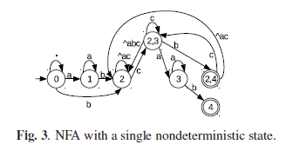
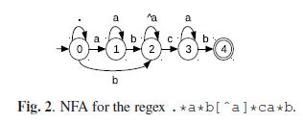
Capturing Group Support
Start Offset Reporting Using Arbitration and Start Offset Reporting Using A Simplified Pack are not general enough to support the capturing groups.
Because nondeterminism cannot be completely removed from all NFA states without loosing the capturing group information.
Notes:
剛剛兩個方法不支援 group capture

Slide 27
Capturing Group Support
Mapping regexs with capturing groups is still a non-trivial task because our architecture allows a limited amount of nondeterminism per state.
For instance, our state machine elements can produce at most two possible next states that are stored in active config and branch config outputs.
Increasing the width of the branch config output to embed multiple next state configurations is possible, but requires a wider interconnection network that is more costly to implement.
Notes:
用 NFA 有一些限制，因為 branch flag 只能支援一個 FSM 啟動，雖可以增加，但就會增加 cost

Slide 28
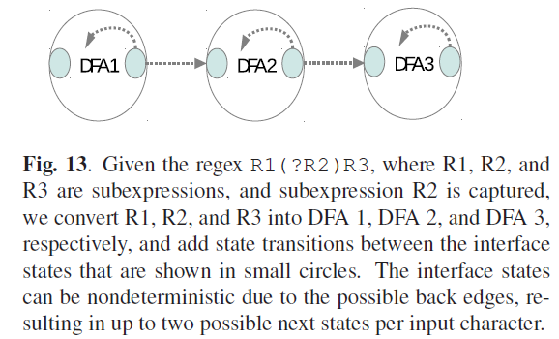
Capturing Group Support
We address this problem by transforming the NFA, where we split the NFA into subexpressions that start or end with the delimiters associated with the capturing groups and we convert the resulting subexpressions individually into deterministic state machines.
Notes:
這個問題可以將 NFA 部分轉成 DFA

Slide 29
Implementation
To optimize the clock frequency for a wide range of regexs, we have pipelined our regex processing into two stages.
  In the first stage, the active state machines compute their next states.
  In the second stage, a pack operation or an arbiter is used to route the branch signals into the load signals.
A single regex pipeline is time-shared by two interleaved text streams, accepting an 8-bit character from each stream every two cycles.
This results in a single-stream throughput rate of 1 Gb/s and an aggregate throughput rate of 2 Gb/s per pipeline assuming a clock frequency of 250 MHz.
Notes:
分兩個 stage

Slide 30
Experiments
We performed experiments on one regex set extracted from a real-life text analytics query [2] and on a regex set that is part of the application layer packet classifier for LinuxTM (i.e., the L7 filter) [18].
We synthesized the architectures that were automatically generated by our compiler using the Quartus II 12.1 software for an Altera Stratix IV GX530 FPGA.

Slide 31
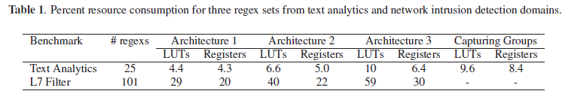
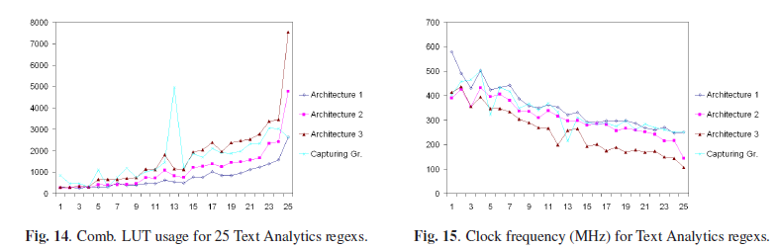
Experiments
Architecture 1: implements the arbitration-based interconnection scheme
Architecture 2: implements the simplified pack network described
Architecture 3: implements the wide pack network

